Slide 1
Do you want to know your real internet speed ?
Is it really fast ?
https://github.com/Romanysoft/SpeedTest

Slide 2
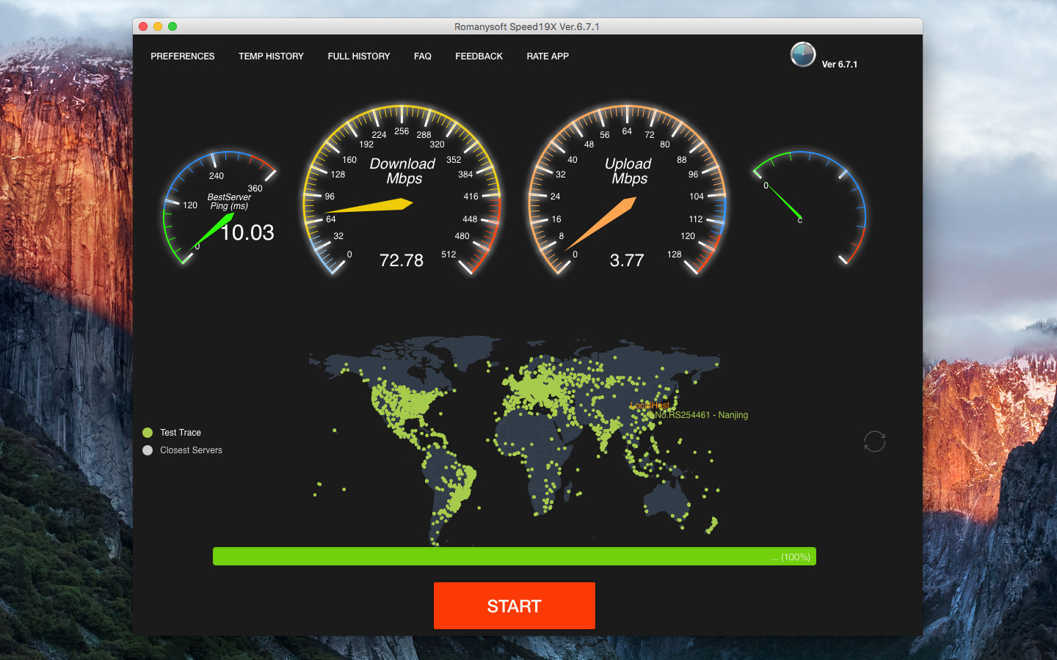
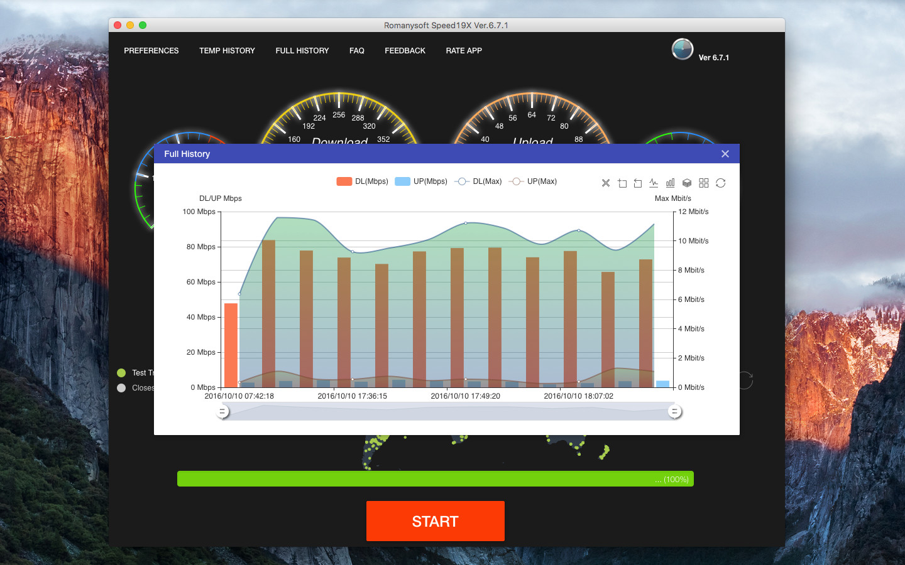
We recommend that you use Romanysoft Speed19X to test, and It will tell you the truth.
https://github.com/Romanysoft/SpeedTest

